Slide 1








Lesson 1. Angular 4 http Service

Slide 2
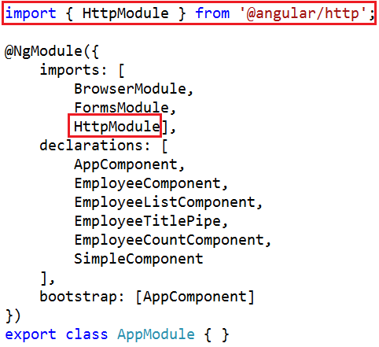
Angular and ASP.NET Web API
Step 1 : Within the root module (AppModule), import the angular HTTP module

Slide 3
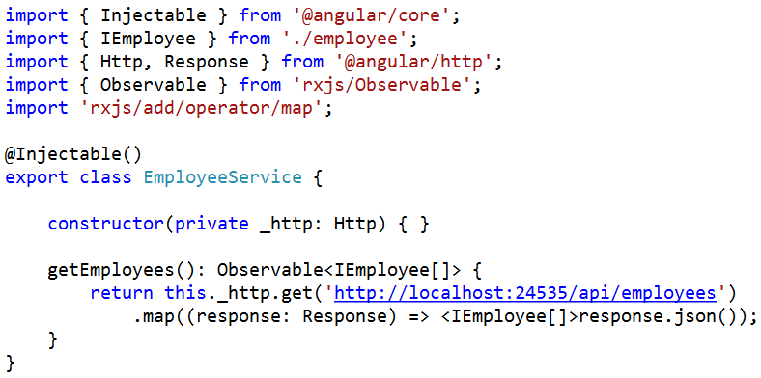
Angular and ASP.NET Web API
Step 2 : Modify EmployeeService to issue a GET request using the built-in http service

Slide 4
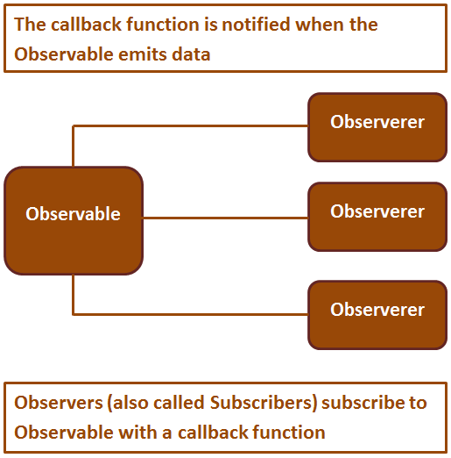
Angular and ASP.NET Web API
What is an Observable

Slide 5
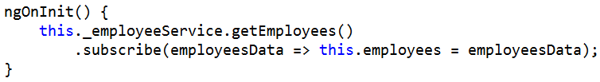
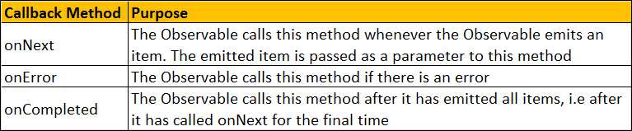
Angular and ASP.NET Web API
Step 3 : From EmployeeListComponent, subscribe to the Observable returned by angular EmployeeService

Slide 6
Q & A
Contact:rashmipawaskar@synergetics-india.com

Slide 7
Thank You

